Slide 1

Tourist attraction recommendation system
Reporter：Lin Jing
Notes:
更多素材资源- B-lue-D-ragonfly- DESIGN

Slide 2

01 Project Background
02 technology
03 Function
04 Operating Model
05 business value
06 Conclusion

Slide 3
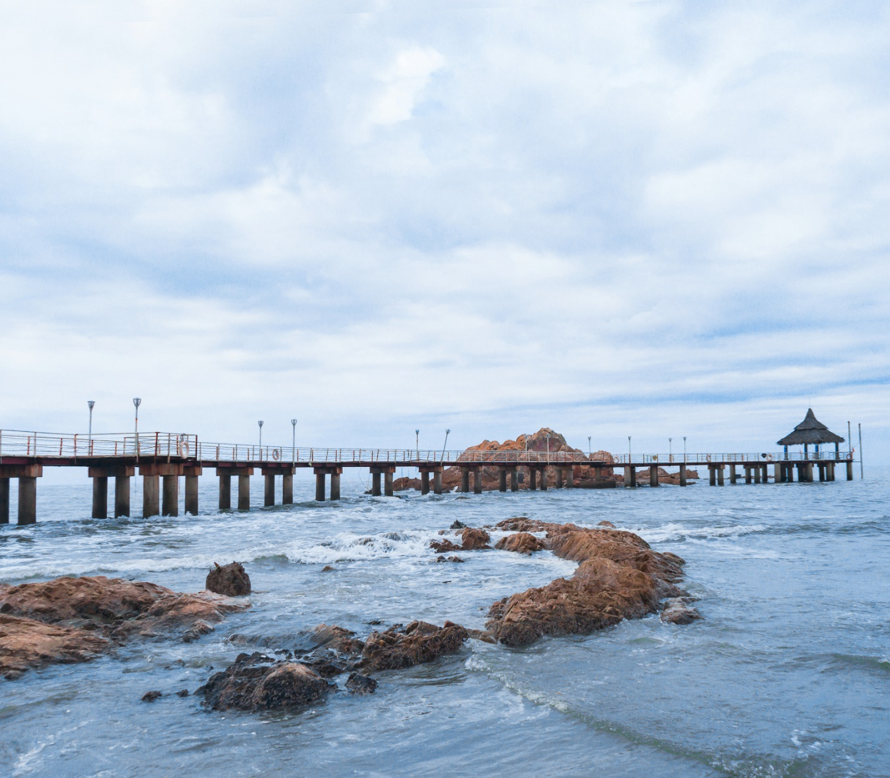
01
Project Background

Slide 4

Macro-environment
Travel business occupies an important position in the market.
With the development of IoT and cloud computing technologies, technology has entered the era of big data.
Micro-environment
Tiktok take flight to scenic spots as quality travel content loses its voice.
Premium travel content faces ‘marginalisation’
Features: The content is not limited to detailed and informative long text travel tips, nor is it singularly aimed at consumers who are interested in travelling.

Slide 5
02
Technology
Something about technology

Slide 6



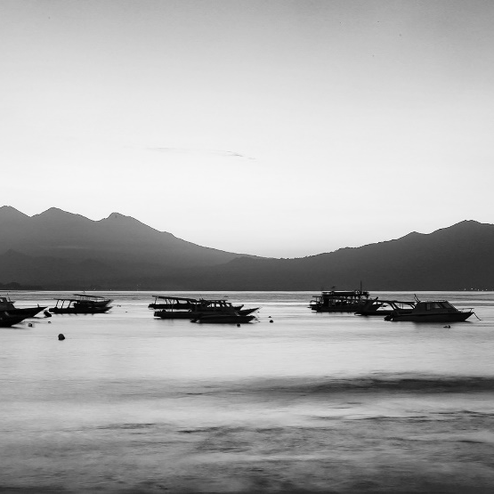
Technology
Navicat
DataGrip
Maxcomputer
DATA：kaggle
ODS,DWD,DWM,DWS
Importing data from a hierarchical warehouse.
Data Warehouses
Data Base
(Based on Django)
Login and Registration
Recommendations Based on Region/Sales/Free Status
Recommendations for Hotels, Restaurants, and Travel Guides
H5+CSS3：动画效果、icomoon
BootStrap：表单样式
Pyecharts：可视化
jQuery
Vscode
Pycharm
Frontend
Backend

Slide 7
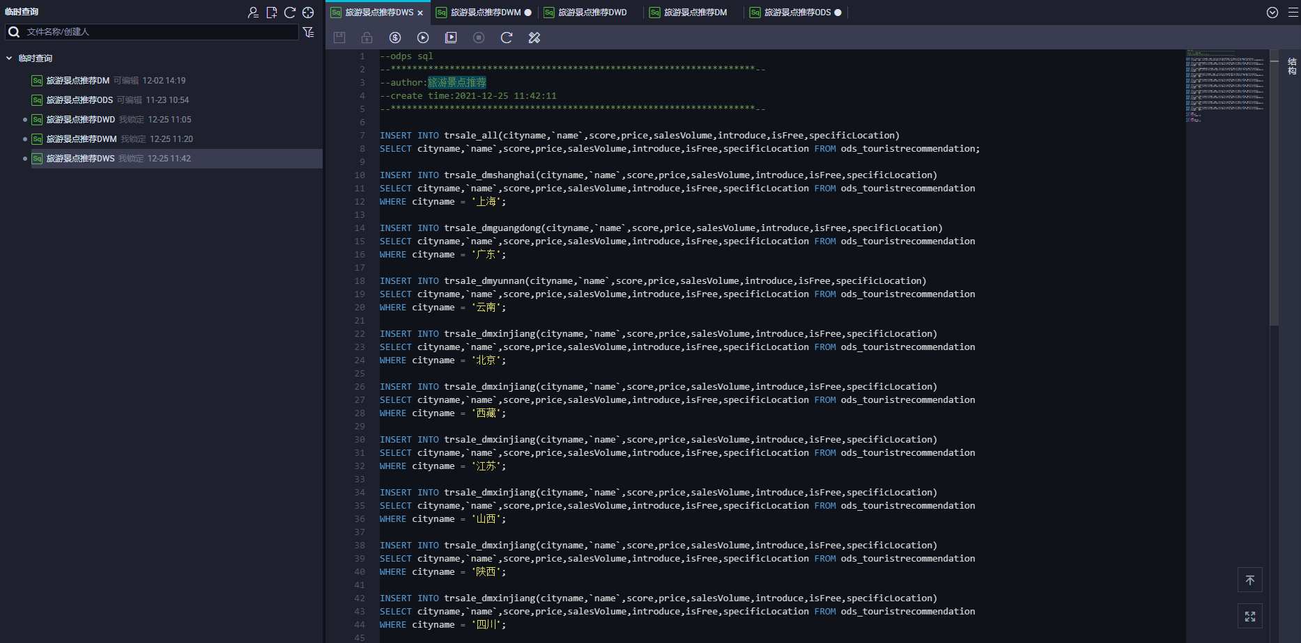
ODS (Operational Data Store): Temporarily store the acquired data sources in the ODS layer.
DWD (Data Warehouse Detail): Perform data cleaning and normalization operations.
DWM (Data Warehouse Middle): Conduct aggregation operations to calculate corresponding statistical indicators.
DWS (Data Warehouse Service): Various applications of data: visualization, recommending tourist attractions, etc.

Slide 8
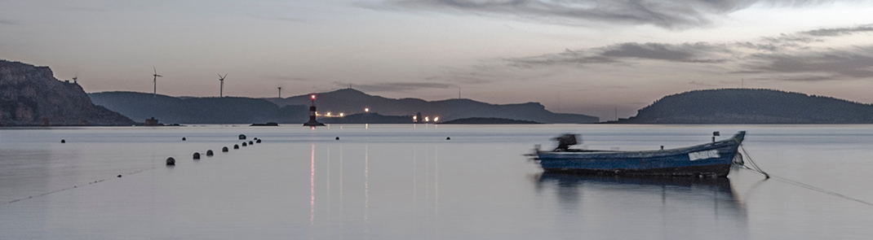
Recommendation Algorithms
Label recommendation binary method Uniqueness of Labels
Recommended popular attractions
(Get the top ten attractions with daily sales volume through SQL)
Free attractions recommendation
(Direct sampling from the data warehouse)
Cold start user(Randomly recommended)

Slide 9
03
Function
Come and see together！

Slide 10
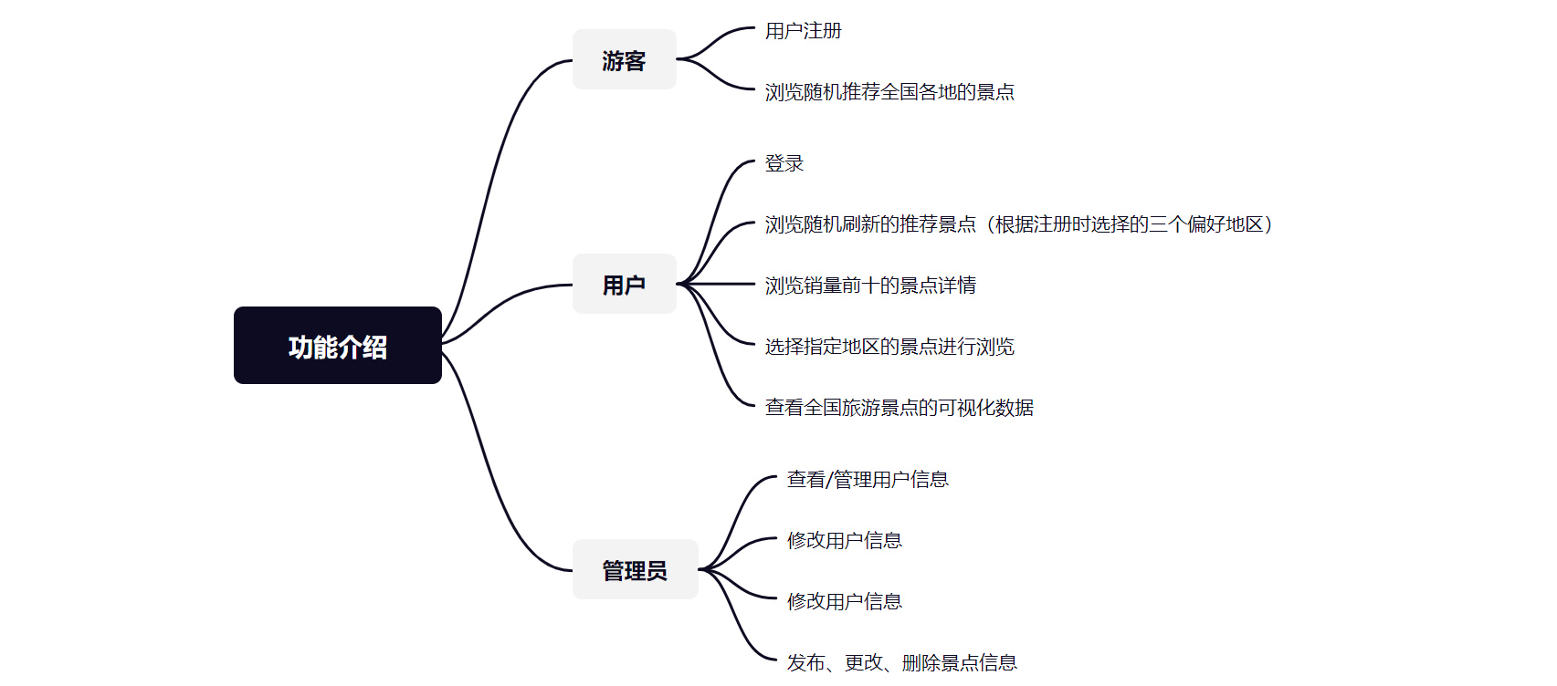


Slide 11
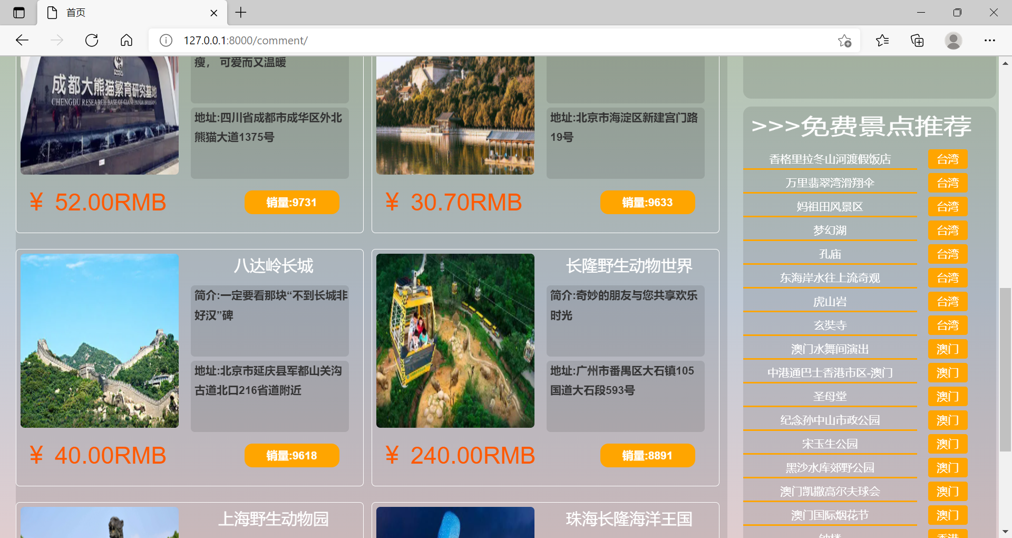
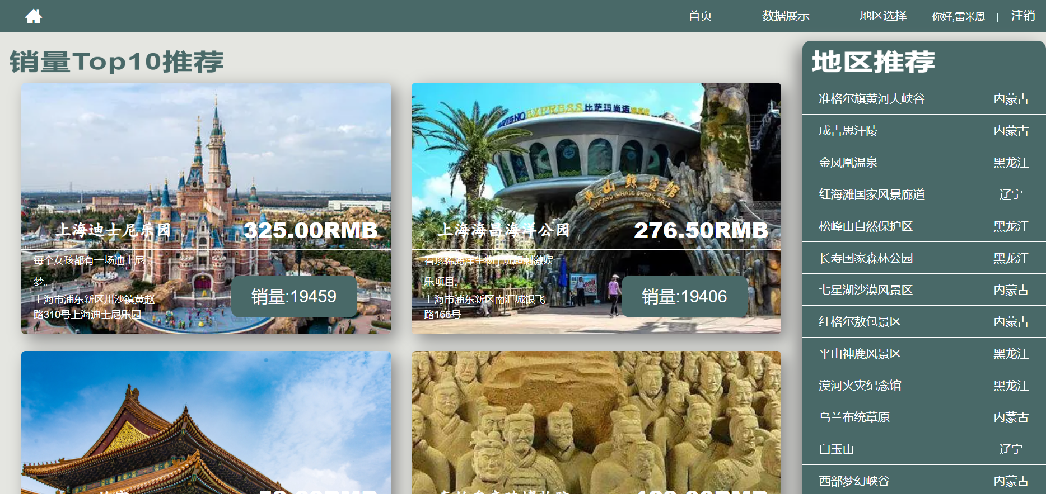

Slide 12
04
Operating
How do we run it?

Slide 13
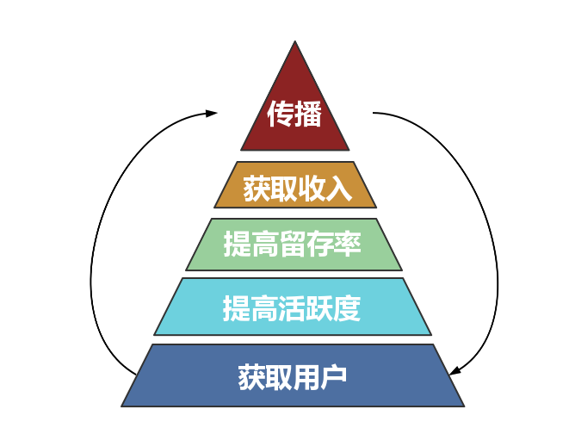

Data-driven operations
用数据来说话、通过数据来驱动业务增长

Slide 14
05
Business Value
Commercial Value

Slide 15



Discounted and convenient hotels and restaurants based on user-selected attractions
Find partner
Cooperation with tourist attractions, according to the user's choice of attraction information, to provide group discounts, for the user to achieve the desire to buy tickets at a discount.
‘loved’Route
Collaborate with experienced travellers and quote travel tips from them. Provide users with different tips for the same attraction.
work with hotels

Slide 16
06
Future
Commercial Value

Slide 17
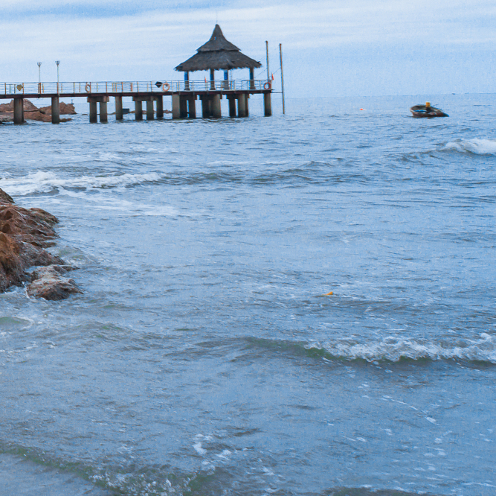
Focus on the needs of older adults.
Giving voice to quality content.
FUTURE
The deepening of the aging degree makes the elderly gradually become the main consumer group of tourism.
The elderly have considerable disposable property
(Starting from the quality of housing resources, travel conditions, tour guide needs, and the humanization of value-added services)
Addressing the Monopoly of Fake Content on Xiaohongshu:
(Collaborating with high-quality travel platforms and their content creators, leveraging data, and attracting users through engaging content)

